Slide 1
Codex Naturalis:
Software Engineering Project
Gruppo 039 - Scaglione SanPietro

Slide 2
Characteristics of the project
Socket & RMI
TUI & GUI
Complete Rules
Multiple matches
All rules and exceptions are implemented.
A Server can host multiple games simultaneously.
Resilience
Players can choose the preferred technology.
A Player can disconnect without losing progress.
Persistance
Players can choose the preferred interface.
A Server Error doesn’t compromise the Game.

Slide 3
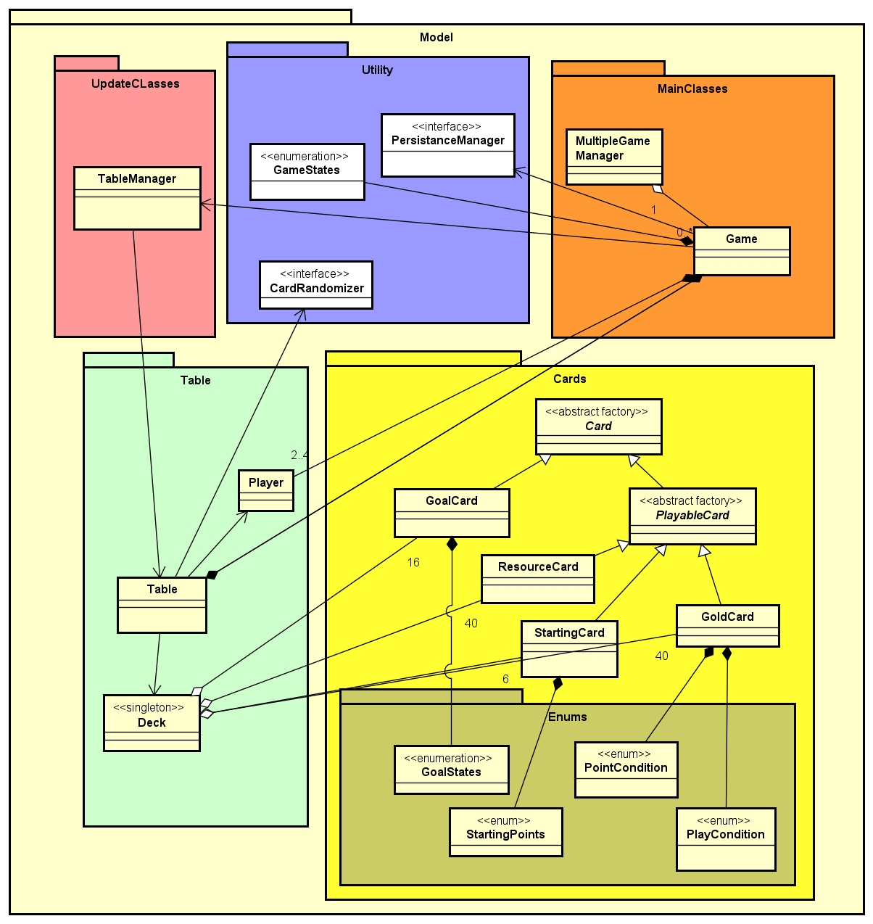
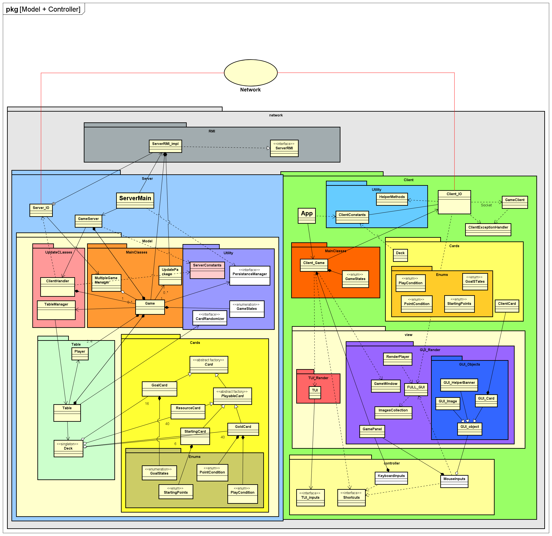
UML Overview
A general comprehensive view on our code's classes and organization.
Model
Implemenents a lot of the basic game rules, especially the Card object.

Slide 4
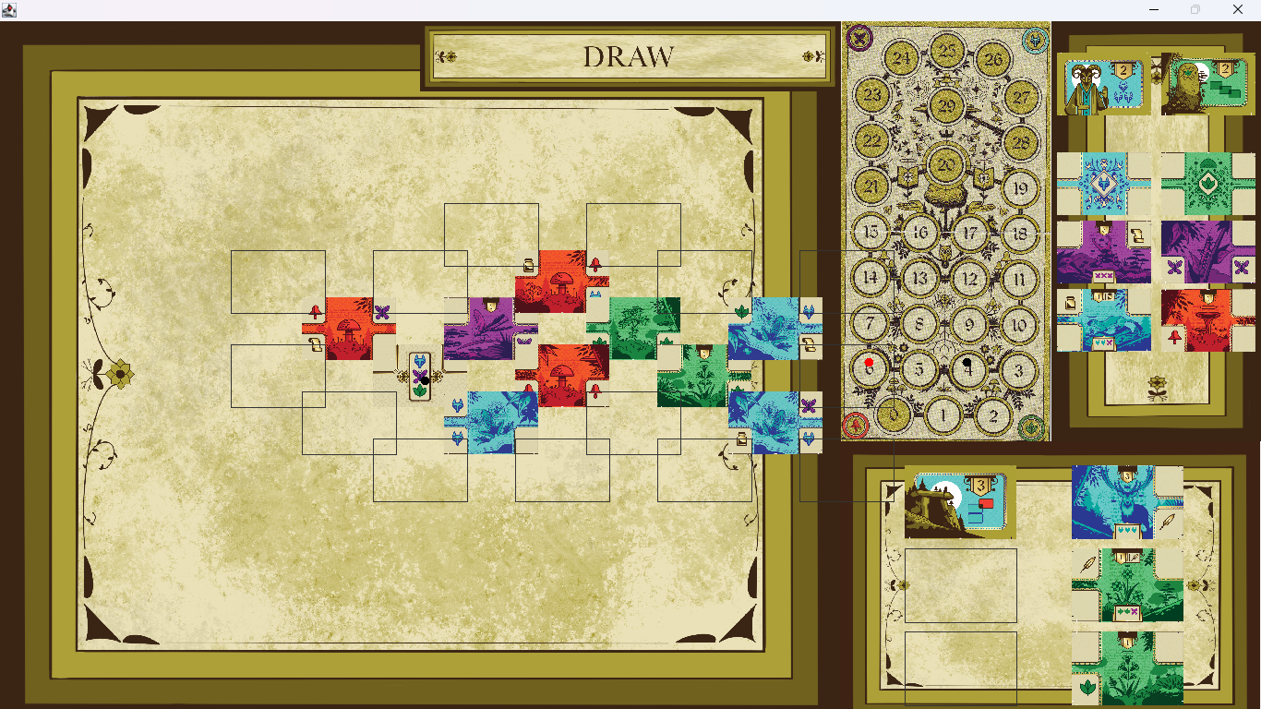
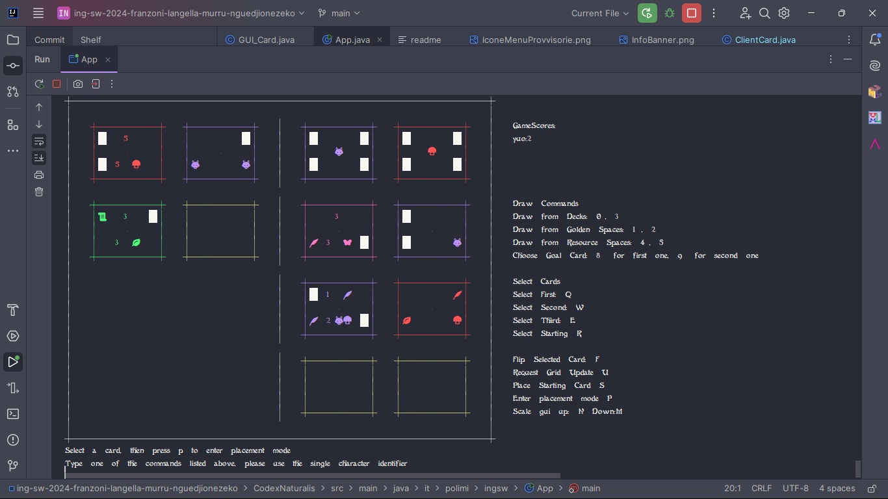
View: User Interface
Unique graphics have been created and added for un optimized GUI experience, with help panels guiding the Player through his turn; the TUI on the other hand has its own specifically designed font in order to display a minaturized version of the Card resources!

Slide 5
A Focus on: Connection!

